Slide 1
Cleaning & Hygiene Suppliers Association “CHSA”
Our Standards. Your Guarantee

Slide 2
We are…
Established in the late 1970s to provide manufacturers with the opportunity to connect with distributors of janitorial products. Launched the first of the respected Accreditation Schemes in the late 1990s.

Slide 3
We are…
Run by our members for our members, we represent all the major manufacturers and distributors supplying cleaning and hygiene products in the UK.

Slide 4
The challenges faced by the maturing market in the 90s
Soft tissue products narrower or shorter
Refuse sacks not fit for purpose
Cotton mops lacking absorbency and with variable weights
Buyers weren’t getting what they paid for!

Slide 5
This prompted the CHSA to introduce its Accreditation Schemes
Our Standards. Your Guarantee

Slide 6
Accreditation schemes
Soft Tissue Scheme established in 1997
Plastic Sack Scheme in 2000 and Mop Scheme in 2007
Accredited Distributor Scheme launched in 2017
Cleaning Chemical Scheme launched in 2020
Owned & managed by CHSA Council through Accreditation Scheme Chairman and elected panels from each of the Schemes

Slide 7
Accreditation ensures
Consistency of supply: customers receive what they order
Accurate labelling: customers get what they pay for
Fully audited manufacturers
Full traceability to manufacturer and batch
What is on the box is what’s in the box!

Slide 8
Independent inspection
Independent Inspector, Martin Yates
Members visited repeatedly each year
Products selected from warehouse and occasionally production line
Label compliance, dimensions, drop test, absorbency
Quality systems audited
Failure to comply may result in expulsion

Slide 9
Admittance demand commitment
An initial audit
Full product range
Quality assurance processes
Four audits in year one
They must maintain the standard achieved to join
Regular audits thereafter

Slide 10
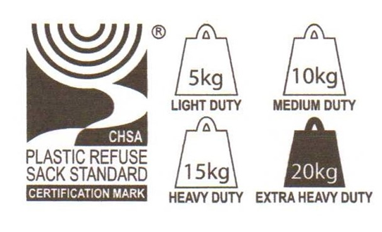
Look for the CHSA marque
Every CHSA Accredited Product is marked with the relevant Accreditation Scheme logo
Fit For Purpose Plastic Refuse Sacks also marked with dumbbell logo, defining duty

Slide 11
The CHSA
Our Standards. Your Guarantee

